Slide 1
Meso level of primary care Working Group
Zagreb, November 2019

Slide 2
Plan of the working group
Part 1 : reminders about the meso level of primary care
Part 2 : status report of the study
Part 3 : what are the next steps : discussion
Part 4 : action plan

Slide 3
Part 1 : What is the meso level?
- Coordinate the delivery of services
- Evaluate the quality of services
- Unite health care professionals
- Support them (expertise, tools)
- Link to community ressources.
WHO Global Report 2002

Slide 4
Primary health care : now more than ever !

Slide 5
POLICY
The country
MACRO
LOCAL/REGIONAL LEVEL
Population of
the area (100 000)
MESO
PRIMARY CARE TEAM LEVEL
MICRO
Patient list
(5000 – 1000)
INTERACTION WITH THE PATIENTS
NANO
1 person/family
Together we change. Jan De Maeseneer et al. 2014

Slide 6
The meso level is essential for…
TO PROVIDE PRACTICE TEAMS WITH SHARED HUMAN AND
Shared responsibility for the health
of the population in the area
Organizational agreements among health care providers, with hospitals and with the social sector to build coordinated care pathways
Pooling human and material resources
among the health care teams

Slide 7
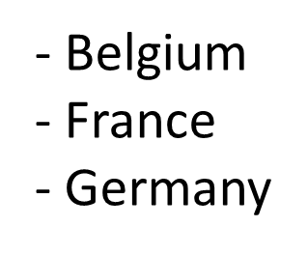
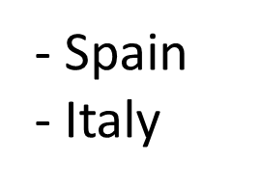
Part 2 : Meso level study
French context : CPTS
What is happening at the meso level abroad?

Slide 8
Qualitative descriptive study
6 young GP, 2 masters in public health, 3 directors
4 to 7 GP key informants by country : snowball sampling
Semi-structured interviews recorded and transcribed
Regular group meetings for analysis
Grey littérature, websites, reports analysis

Slide 9
4 clinical cases
A schizophrenic woman has a breast cancer and needs chemotherapy sessions, she is very anxious.
A frail elderly person with few ressources needs home care services.
A diebetic and obese person need to switch to insulin and have therapeutic education.
A man at the end of his life with multimetastatic cancer wants to stay at home surrounded by his family.
3 open questions : access to care for vulnerable people, out of hours care, prevention and screenings.
Health care professionals support : needs analysis, continuing education, mutualization of ressources.

Slide 10
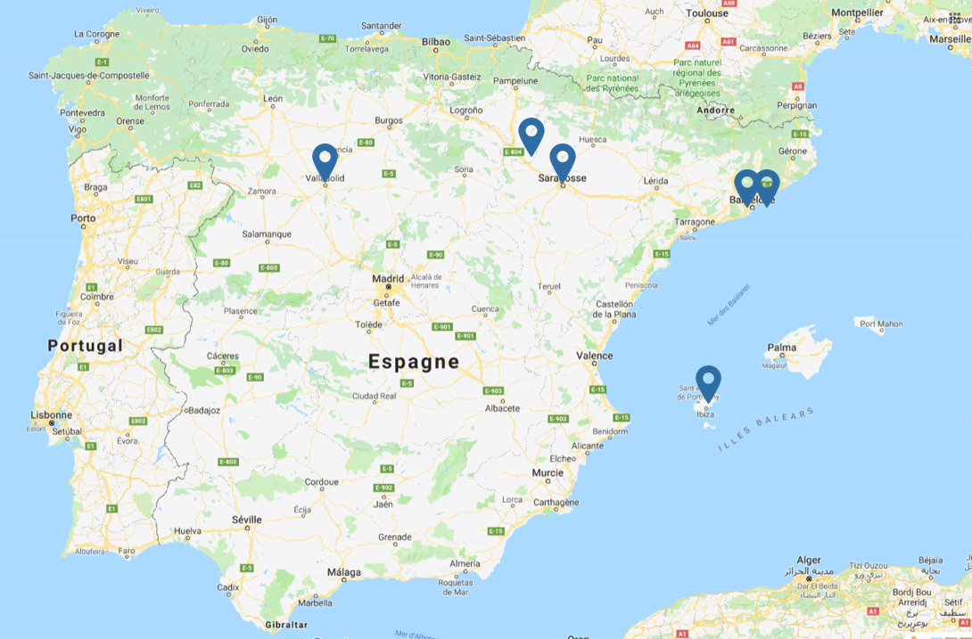
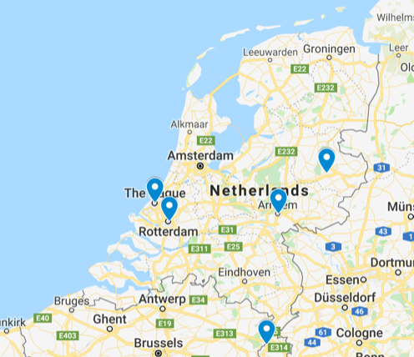
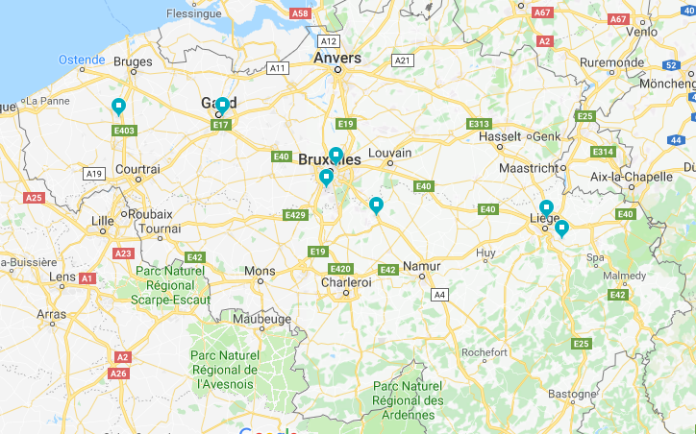
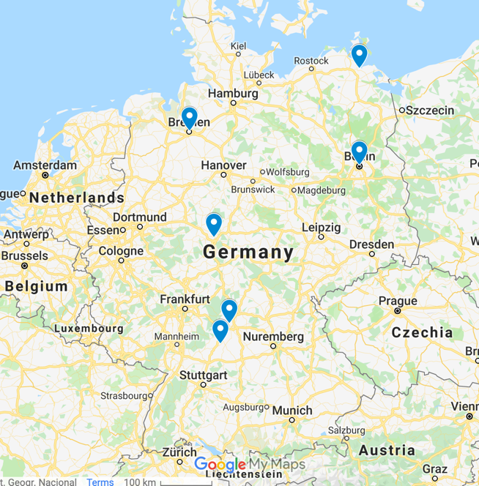
Spain
Netherlands
Belgium
Germany

Slide 11
Some inspiring results from Belgium …

Slide 12
Belgium : The circles of general practitioners
Association of all the GPs in the area.
All the country is covered.
Family medicine out of hours
2002, federal level, specific missions : GPs representation, meeting point with local policy, accessibility to GPs consultations for the population, multidisciplinary collaboration, partnerships with hospital.
2015, regional level, non-profit organizations, subsidized
Starting point… At the crossroads…

Slide 13
Local multidisciplinary network
Out of hours care
GP circle
Support team in palliative care
Consultation platform Gps-SPs
…

Slide 14
Belgium : The SYLOS, consultation platform
Population of responsability
SYLOS = Local health system
Consultation platform : meetings between GPs and specialists animated by a moderator to implement actions or coordination programs. Research team leads the activity by « action research » method.
Long delay in setting up and a low level of interprofessional knowledge.
Coordination and dynaisation structure
Integration of care
1st line services
2nd line services

Slide 15
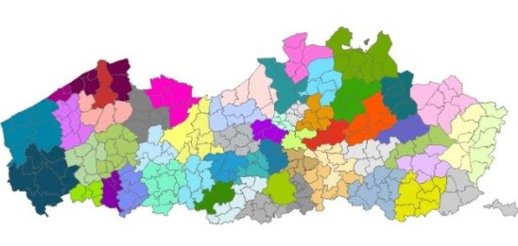
Belgium : The primary care zones
60 primary care zones
8 transition coachs
Primary care zone
PC networks
PC practice
PC practice
75000-125000
5000-10000
< 5000-10000

Slide 16
Part 3 : Discussion about the next steps
Results for Italy and UK, make a synthesis of all.
Refine the results with country experts ? Country delegates ?
Write a paper on the meso level development in 7 european countries / … on the role of the meso level in QI.
Make a questionnaire to describe the meso level of primary care in a european country ?
Follow up the meso level development of PC in European countries ?
Other ideas ?

Slide 17
Part 4 : Action plan
Do you want to participate?
What could you do?
Thank you !

